Slide 1

Neural Networks

Slide 2
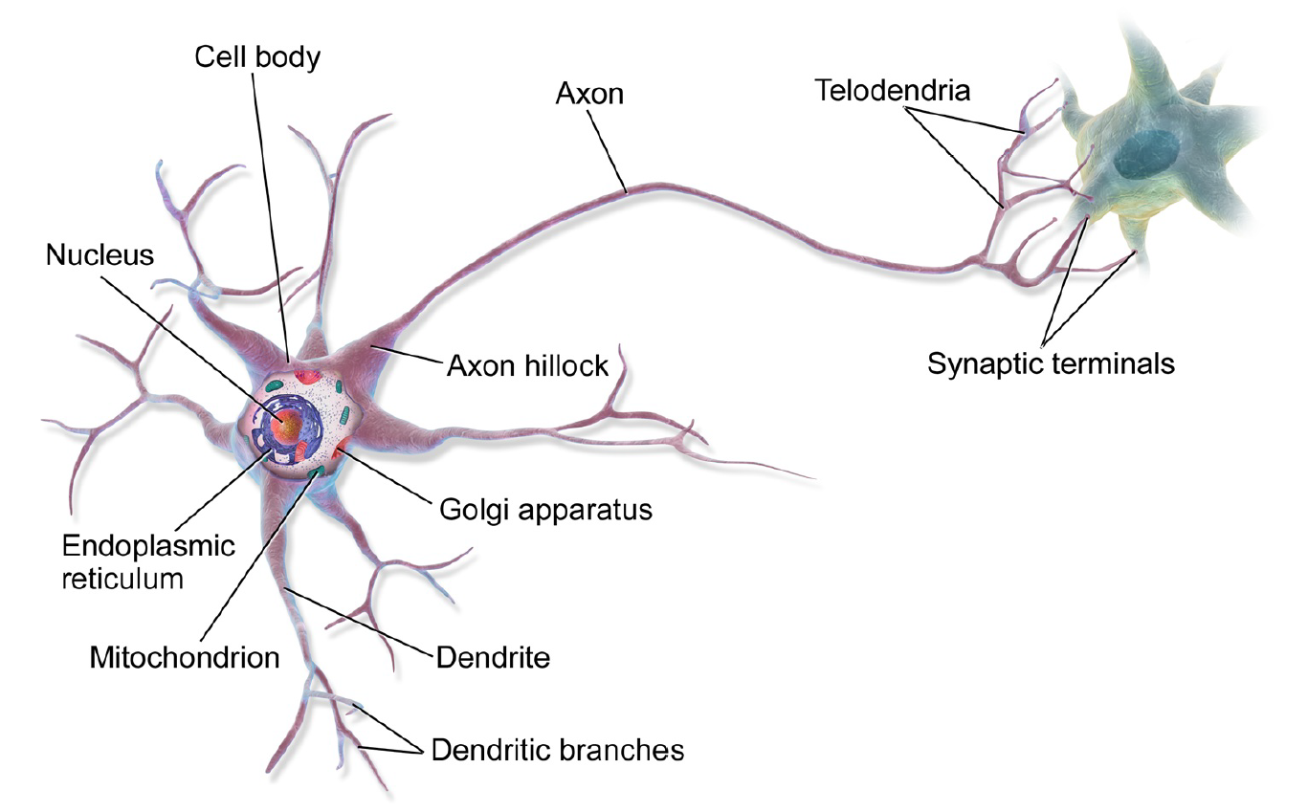
Biological Neuron

Slide 3
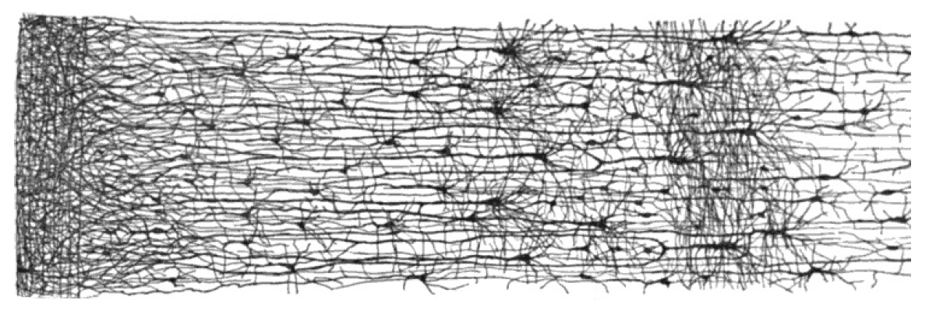
Biological Neural Network

Slide 4
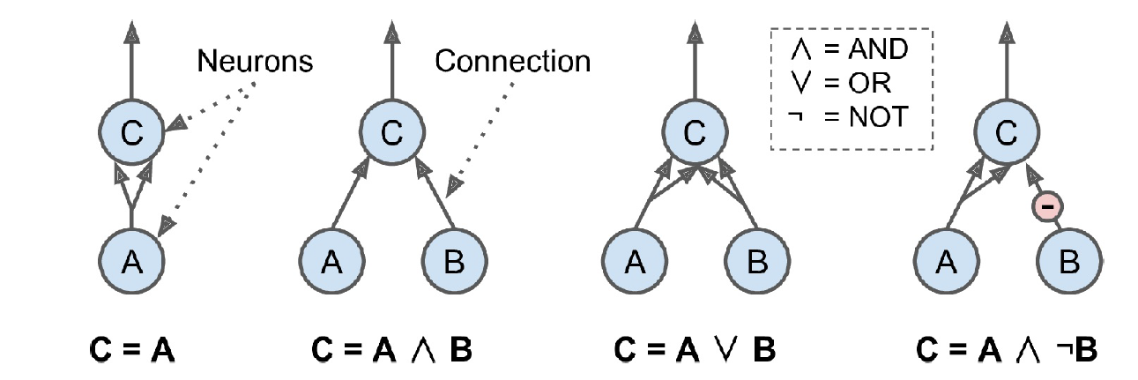
Logical Neuron

Slide 5
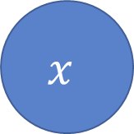
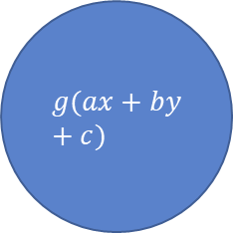
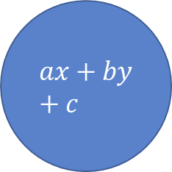



Artificial Neuron
$$x$$
$$a$$
$$ax+by+c$$
$$g(ax+by+c)$$
$$y$$
$$b$$
linear
activation

Slide 6

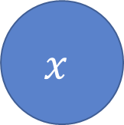



Artificial Neuron
$$x$$
$$a$$
$$∑$$
$$y$$
$$b$$
linear
activation

Slide 7
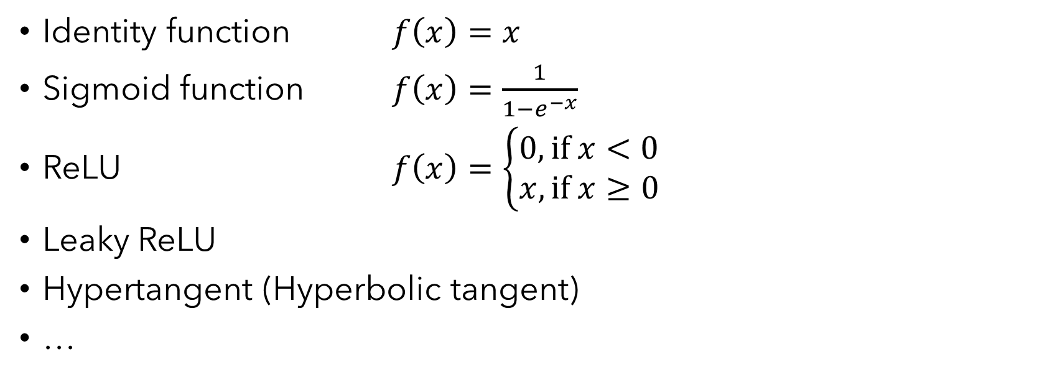
Activation Functions
Identity function $f\left(x\right)=x$
Sigmoid function $f\left(x\right)=\frac{1}{1−e^{−x}}$
ReLU $f\left(x\right)=\left\{\begin{aligned}0, if x<0 \\ x, if x≥0\end{aligned}\right.$
Leaky ReLU
Hypertangent (Hyperbolic tangent)
…

Slide 8
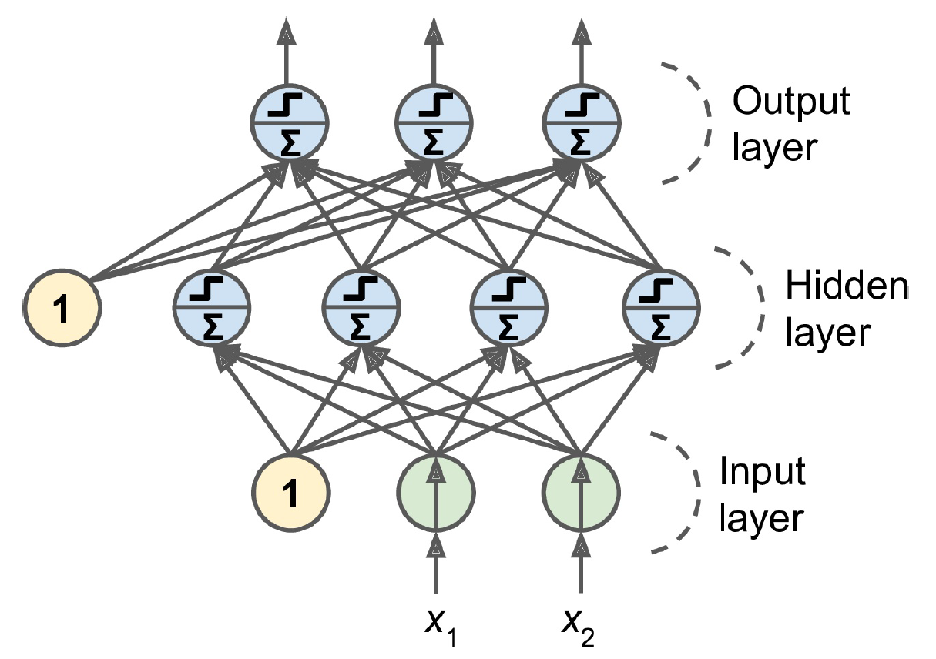
Multilayer Perception (MLP)

Slide 9

Notations
$m$ : number of examples in the dataset
$n_{x}$ : input size
$n_{y}$ : output size (or number of classes)
$n_{h}^{\left[l\right]}$ : number of hidden units of the $l$-th layer. In a for loop, it is possible to denote $n_{x}=n_{h}^{\left[0\right]}$and $n_{y}=n_{h}^{\left[L +1\right]}$
$L$ : number of hidden layers in the network

Slide 10

Notations
Ignore “1” by absorbing into $x^{[i]}$
$W^{[l]}$ is the transformation matrix for layer $l$
$b^{[l]}$ is the constant term for layer $l$
$X=\left[\begin{matrix}\begin{aligned}\begin{aligned}| \\ x^{\left(1\right)}\end{aligned} \\ |\end{aligned} & \begin{aligned}\begin{aligned}| \\ x^{\left(2\right)}\end{aligned} \\ |\end{aligned}\end{matrix} \begin{matrix}⋯ & \begin{aligned}\begin{aligned}| \\ x^{\left(m\right)}\end{aligned} \\ |\end{aligned}\end{matrix}\right]$, $X$ is a $n_{x}×m$ matrix
$Y$ is a $n_{y}×m$ label matrix
$g^{\left[l\right]}$ is the $l$-th layer activation function

Slide 11
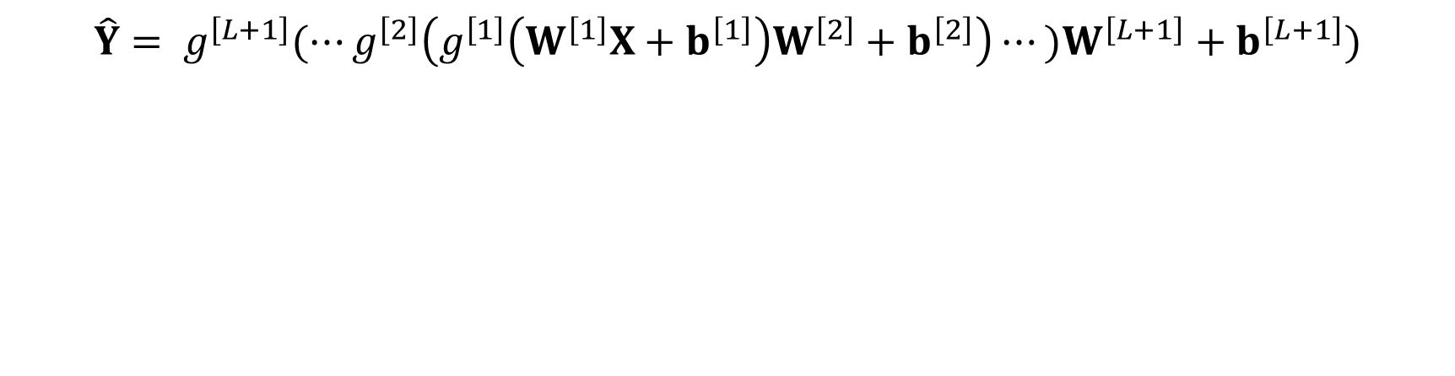
Mathematical Representation
$$\hat{Y}= g^{\left[L+1\right]}(⋯g^{\left[2\right]}\left(g^{\left[1\right]}\left(W^{\left[1\right]}X+b^{\left[1\right]}\right)W^{\left[2\right]}+b^{\left[2\right]}\right)⋯)W^{\left[L+1\right]}+b^{\left[L+1\right]})$$

Slide 12
Example

Slide 13







Forward Propagation
$$⋯$$
$$⋮$$
$$⋮$$
$$⋮$$
$$⋮$$
$$⋮$$
$$⋮$$
$$⋮$$

Slide 14
Backpropagation
$$⋯$$
$$⋮$$
$$⋮$$
$$⋮$$
$$⋮$$
$$⋮$$
$$⋮$$
$$⋮$$

Slide 15
Why Backpropagation?
What are the unknowns?

Slide 16

Read scikit-learn Documentation

